Slide 1
6.9: Survival Analysis and Censored Data
Kamilah Ebrahim
The University of Toronto
6.9: Survival Analysis and Censored Data

Slide 2
Introduction
Survival analysis and censored data are related to the analysis of the outcome variable best described as “the time until and event occurs”. Some examples include:
Predicting survival time of patients diagnosed with cancer. Predicting the time a customer will cancel a subscription. Predicting the customer wait time for a call centre.
6.9: Survival Analysis and Censored Data

Slide 3
Introduction
Some examples include:
Predicting survival time of patients diagnosed with cancer. Predicting the time a customer will cancel a subscription. Predicting the customer wait time for a call centre.
6.9: Survival Analysis and Censored Data

Slide 4
Survival and Censoring Times
For each individual we assume there exists:
𝑇 : the true survival time which represents the time at which the event of interest o
𝐶: the true censoring time which is when the censoring occurs.
Ex: The time at
which the patient drops out of the study.
However, we only ever observe the time that comes first:
𝑌 = min(𝑇 , 𝐶)
In order to keep track of which time 𝑌 represents, we also have a status indicator:
1 if 𝑇 ≤ 𝐶
𝛿 = {
0
6.9: Survival Analysis and Censored Data

Slide 5
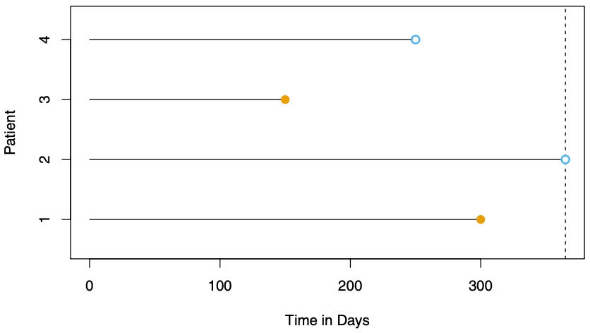
Survival and Censoring Times
Suppose we have the following data from a medical study with 𝑛 = 4 patients. We observe 4 pairs of (𝑌 , 𝛿), denoted as (𝑦₁, 𝛿₁), … , (𝑦₄, 𝛿₄).
For patient 1 and 3, we observe the time to the event (i.e. death) during the study.
_{P} Thus, 𝛿₁ = 𝛿₃ = 1
atient 2 survives until the end of the study.
_{P} Thus, 𝛿₂ = 0
atient 4 drops out of the study early.
Thus, 𝛿₄ = 0
6.9: Survival Analysis and Censored Data

Slide 6
Independent Censoring
We assume that the censoring mechanism is independent. That is, the event time 𝑇 is independent of the censoring time 𝐶.
Example of a violation:
Some patients drop out of a cancer study because they are very sick.
If we analyse the data without considering why patients drop out then we will overestimate the true average survival time.
The data collection process must be examined closely to check whether independent censoring is a reasonable assumption.
6.9: Survival Analysis and Censored Data

Slide 7
The Kaplan-Meier Survival Curve
The Kaplan-Meier survial curve (or survival function) is a decreasing function that quantifies the probability of surviving past time 𝑡. It is defined by
𝑆(𝑡) = Pr(𝑇 > 𝑡)
Estimating 𝑆(𝑡) is complicated by the presence of censoring but we have an approach to
overcome this challenge.
_{i}𝑑_{n1di}<_{vid}𝑑_{u2a}<_{ls.} ⋯ < 𝑑_{𝑛} denote the 𝐾 unique survival times among the non-censored
𝑞_{𝑘} denotes the number of events that took place at time 𝑑_{𝑘}. (i.e. the number of patients that died at time 𝑑_{𝑘})
𝜏 denotes the number of individuals alive and in the study just before 𝑑 (the at risk
𝑘 𝑘
patients).
The set of patients that are at risk are the risk set.
6.9: Survival Analysis and Censored Data

Slide 8
The Kaplan-Meier Survival Curve
So, the probability of surviving past time 𝑑_{𝑘} is given by:
𝑆 (𝑑_{𝑘}) = Pr (𝑇 > 𝑑_{𝑘}) = Pr (𝑇 > 𝑑_{𝑘} ∣ 𝑇 > 𝑑_{𝑘−1}) Pr (𝑇 > 𝑑_{𝑘−1}) .
Note that Pr (𝑇 > 𝑑_{𝑘−1}) amounts to 𝑆 (𝑑_{𝑘−1}). So,
𝑆 (𝑑_{𝑘}) = Pr (𝑇 > 𝑑_{𝑘} ∣ 𝑇 > 𝑑_{𝑘−1}) 𝑆 (𝑑_{𝑘−1}) .
Thus,
𝑆 (𝑑_{𝑘}) = Pr (𝑇 > 𝑑_{𝑘} ∣ 𝑇 > 𝑑_{𝑘−1}) × ⋯ × Pr (𝑇 > 𝑑₂ ∣ 𝑇 > 𝑑₁) Pr (𝑇 > 𝑑₁)
Now we need the estimates for each of these terms.
6.9: Survival Analysis and Censored Data

Slide 9
The Kaplan-Meier Survival Curve
The estimator
P̂r (𝑇 > 𝑑_{𝑗} ∣ 𝑇 > 𝑑_{𝑗−1}) = (𝜏_{𝑗} − 𝑞_{𝑗}) /𝜏_{𝑗}
is the fraction of the risk set at time 𝑑 who survived past time 𝑑 . So, the Kaplan-Meier
𝑗 𝑗
estimator of the survival curve is
𝑘
𝜏 − 𝑞
̂
𝑗 𝑗
𝑆 (𝑑 ) = ∏ (
)
𝑘
𝜏
𝑗=1
𝑗
For times 𝑡 between 𝑑_{𝑘} and 𝑑_{𝑘+1} we set 𝑆̂(𝑡) = 𝑆̂(𝑑_{𝑘}). This gives the Kaplan-Meier survival curve a step-like shape.
6.9: Survival Analysis and Censored Data

Slide 10
Exercise: The Kaplan-Meier Survival Curve
Open the Survival Analysis and Censored Data R Markdown or Jupyter Notebook file.
Go over the “The Kaplan-Meier Survival Curve” section together as a class.
6.9: Survival Analysis and Censored Data

Slide 11
The Log-Rank Test
The log-rank test aims to test the null hypothesis that there is no difference between two survival curves. The statistic is computed with
_{𝑊 =} 𝐸 − E(𝐸)
√
Var(𝐸)
where E(𝐸) and Var(𝐸) are the expectation and variance under the assumption of the null hypothesis.
6.9: Survival Analysis and Censored Data

Slide 12
The Log-Rank Test
Suppose we want to compare the survival of two groups of people by comparing the two survival curves.
Recall:
𝑑₁ < 𝑑₂ < ⋯ < 𝑑_{𝑛} are the unique survival times among the non-censored individuals.
𝜏_{𝑘} is the number of individuals at risk at time 𝑑_{𝑘}.
𝑞_{𝑘} denotes the number of patients that died at time 𝑑_{𝑘}
Now we define:
𝜏_{1𝑘}, 𝜏_{2𝑘} are the number of individuals at risk at time 𝑑_{𝑘} in group 1 and 2 respectively.
𝑞_{1𝑘}, 𝑞_{2𝑘} are the number of patients that died at time 𝑑_{𝑘} in group 1 and 2 respectively. Note that 𝜏_{1𝑘} + 𝜏_{2𝑘} = 𝜏_{𝑘} and 𝑞_{1𝑘} + 𝑞_{2𝑘} = 𝑞_{𝑘}.
6.9: Survival Analysis and Censored Data

Slide 13
The Log-Rank Test
At each death time 𝑑_{𝑘}, we have the following table:
 | Group | 1 | Group 2 |  | Total
Died Survived | 𝜏 ^{𝑞}−^{1𝑘}𝑞 1𝑘_{𝜏} | 1𝑘 | _{𝜏} ^{𝑞}₋2𝑘 2𝑘_{𝜏} | ^{𝑞}2𝑘 | 𝜏_{𝑘} ^{𝑞}−^{𝑘} 𝑞_{𝑘} 𝜏
Total | 1𝑘 | 2𝑘 |  |  | 𝑘
𝜏
_{𝜏}^{1ℎ} is the proportion of at risk individuals that are in group 1.
ℎ
If there is no difference in the survival rate between the two groups, we would expect
𝜏
1ℎ
𝑞_{𝑘} individuals in group 1 to die at time 𝑑_{𝑘}.
𝜏
ℎ
^{𝜏}1ℎ
So, E (𝑞_1𝑘) = 𝑞_
𝑘 is the expected number of deaths at time 𝑑 in group 1.
𝜏
𝑘
ℎ
6.9: Survival Analysis and Censored Data

Slide 14
The Log-Rank Test
In our case, the log rank test statistic is computed with
_{𝑊 =} ∑^{𝑛}_{𝑘=1} (_{𝑛}𝑞_{1𝑘} − E (𝑞_{1𝑘}))
√∑_{𝑘=1} Var (𝑞_{1𝑘})
where
𝑞_{𝑘} (𝜏_{1𝑘}/𝜏_{𝑘}) (1 − 𝜏_{1𝑘}/𝜏_{𝑘}) (𝜏_{𝑘} − 𝑞_{𝑘})
Var (𝑞_{1𝑘}) =
.
𝜏_{𝑘} − 1
When the sample size is large, 𝑊 has approximately a standard normal distribution.
Then, a 𝑝-value can be used to test the null hypothesis that there is no difference between the survival curves of the two groups.
6.9: Survival Analysis and Censored Data

Slide 15
Exercise: The Log-Rank Test
Open the Survival Analysis and Censored Data R Markdown or Jupyter Notebook file.
Go over the “The Log-Rank Test” section together as a class.
6.9: Survival Analysis and Censored Data

Slide 16
Regression with a Survival Response
Suppose we would like to fit a regression model to survival data with the following properties.
𝑛 observations (𝑌 , 𝛿)
𝑌 = min(𝑇 , 𝐶).
_{𝐸 ∈}𝛿 equals 1 if 𝑌 = 𝑇 and 0 otherwise.
𝖠^{𝑝} is a vector of 𝑝 features.
We want to predict the true survival time 𝑇 .
Note that we want to predict 𝑇 , not 𝑌 . Censoring makes this diﬀicult so we make use of the
hazard function.
6.9: Survival Analysis and Censored Data

Slide 17
The Hazard Function
The hazard function ℎ(𝑡) is the death rate in the instant after time 𝑡, given survival past that time. That is,
_{ℎ(𝑡) = Δli𝑡m→0} Pr(𝑡 < 𝑇 ≤ 𝑡_{Δ}+_{𝑡} Δ𝑡 ∣ 𝑇 > 𝑡)
where 𝑇 is the unobserved survival time. We take the limit as Δ𝑡 approached zero so we can think of Δ𝑡 as an extremely small number.
Now we want to use the hazard function to model the survival time as a function of the covariates 𝑥_{𝑖𝑗}.
6.9: Survival Analysis and Censored Data

Slide 18
The Proportional Hazards Assumption
The proportional hazards assumption states
ℎ (𝑡 ∣ 𝑥_{𝑖}) = ℎ₀(𝑡) exp (∑^{𝑝} 𝑥_{𝑖𝑗}𝛽_{𝑗})
𝑗=1
ℎ_{function0}(𝑡) ≥ 0 is an unspecified function known as the baseline hazard which is the hazard for an individual with features 𝑥_{𝑖1} = ⋯ = 𝑥_{𝑖𝑝} = 0.
exp (∑^{𝑝}_{𝑗=1} 𝑥_{𝑖𝑗}𝛽_{𝑗}) is called the relative risk for the feature vector 𝑥_{𝑖} = (𝑥_{𝑖1}, … , 𝑥_{𝑖𝑝})
relative to 𝑥_{𝑖} = (0, … , 0).
-𝛽 = (𝛽 , 𝛽 , … , 𝛽 ) are the parameters that we need to estimate using the likelihood (we will
0 1 𝑝
not present the likelihood function).
6.9: Survival Analysis and Censored Data

Slide 19
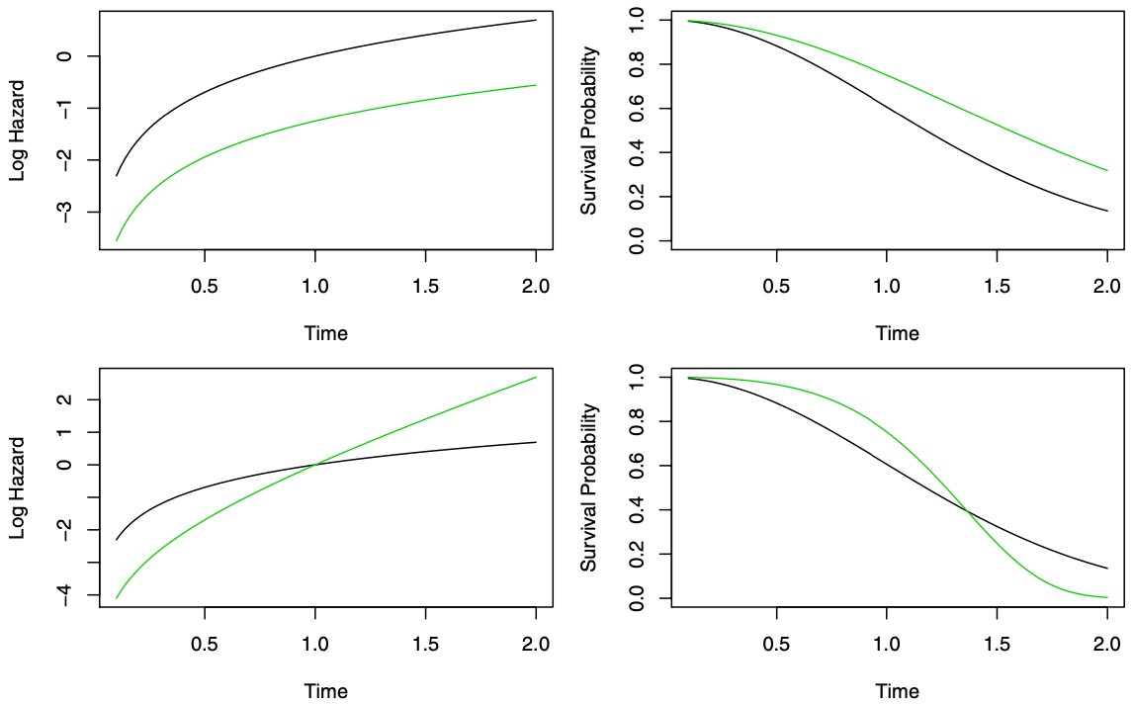
The Proportional Hazards Assumption
Since the baseline hazard function ℎ₀(𝑡) is unspecified the only assumption we are making is that a one-unit increase in 𝑥_{𝑖𝑗} corresponds to an increase in ℎ(𝑡|𝑥_{𝑖}) by a factor of exp (𝛽_{𝑗}).
Two models with a
binary covariate 𝑥 .
𝑖
Left plots show the log hazards and right plots show the survival functions.
Green is for 𝑥_{𝑖} = 0 and
black is for 𝑥 = 1.
𝑖
Top model satisfies the assumption.
Bottom model doesn’t satisfy the assumption.
6.9: Survival Analysis and Censored Data

Slide 20
Cox Proportional Hazards Model
Because ℎ₀(𝑡) in the proportional hazards assumption is unknown we cannot plug ℎ(𝑡|𝑥_{𝑖}) into the likelihood to get estimates for 𝛽 = (𝛽₁, … , 𝛽_{𝑝}).
Cox’s proportional hazards model says that it it possible to estimate 𝛽 without specifying the form of ℎ₀(𝑡).
Use the partial likelihood which is valid regardless of the the value of ℎ₀(𝑡). Maximize the partial likelihood with respect to 𝛽.
We can obtain 𝑝-values corresponding to null hypotesis such as 𝐻₀ ∶ 𝛽_{𝑗} = 0. We can obtain confidence intervals associated with the estimated coeﬀicients.
6.9: Survival Analysis and Censored Data

Slide 21
Cox Proportional Hazards Model
Suppose we have a single binary predictor 𝑥 ∈ {0, 1} and we want to determine whether there
𝑖
is a difference between the survival times of the observations in the two groups.
Approach #1: Fit a Cox proportional hazards model and test the null hypothesis
𝐻₀ ∶ 𝛽 = 0.
Approach #2: Perform a log-rank test to compare the two groups.
In the case of a binary predictor both methods will yield the same result!
6.9: Survival Analysis and Censored Data

Slide 22
Exercise: The Cox Proportional Hazards Model
Open the Survival Analysis and Censored Data R Markdown or Jupyter Notebook file. Go over the “The Cox Proportional Hazards Model” section together as a class.
6.9: Survival Analysis and Censored Data

Slide 23
References
Chapter 11 of the ISLR2 and ISLP books:
James, Gareth, et al. “Survival Analysis and Censored Data.” An Introduction to Statistical Learning: with Applications in R, 2nd ed., Springer, 2021.
James, Gareth, et al. “Survival Analysis and Censored Data.” An Introduction to Statistical Learning: with Applications in Python, Springer, 2023.
6.9: Survival Analysis and Censored Data

